Slide 1

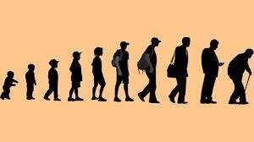
LIFE EXPECTANCY PREDICTION
Machine Learning and Artificial Intelligence

Slide 2
INTRODUCTION
In recent years, the field of machine learning has gained significant momentum in various domains, revolutionizing how we solve complex problems. One such critical area where machine learning can make a profound impact is healthcare. The ability to predict life expectancy accurately can aid policymakers, government officials, and individuals in making informed decisions and implementing targeted interventions to improve overall population health.
Understanding the factors that influence life expectancy is of utmost importance in addressing public health challenges and promoting well-being. By developing an accurate predictive model, we can identify patterns, relationships, and risk factors associated with different populations, ultimately facilitating evidence-based interventions and resource allocation

Slide 3
DEVELOPING THE MODEL
The country and year in which the data from the dataset collected is not used to forecast life expectancy.
The project will employ a multidimensional approach to life expectancy prediction, utilizing a diverse dataset consisting of historical health records, population demographics, lifestyle indicators, economic factors.
Dataset is taken from WHO repository.
Machine learning algorithms, such as Linear Regression, Random Forest, and some other algorithms have been employed to develop an accurate predictive model.
Performance metrics used are R² scores.
Various Exploratory Data Analysis tools are used such as scatter plots, heat maps and pair plots.

Slide 4
About the model
dataset
features
algorithms
Dataset is taken from WHO repository (Life Expectancy Data.csv)
It has 22 features and 2938 data points.
The features are:
Country, Year, Status, Life Expectancy, Adult mortality, infant deaths, alcohol, percentage expenditure, Hepatitis B, Measles, BMI, under-five deaths, polio, total expenditure, Diphtheria, AIDS, GDP, population, thinness 1-19Y, thinness 5-9Y, Income composition of resources, Schooling
Linear regression
Random Forest Regression
Decision Tree Regression
Ridge Regression

Slide 5
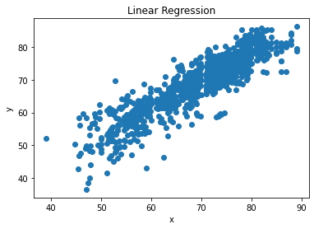
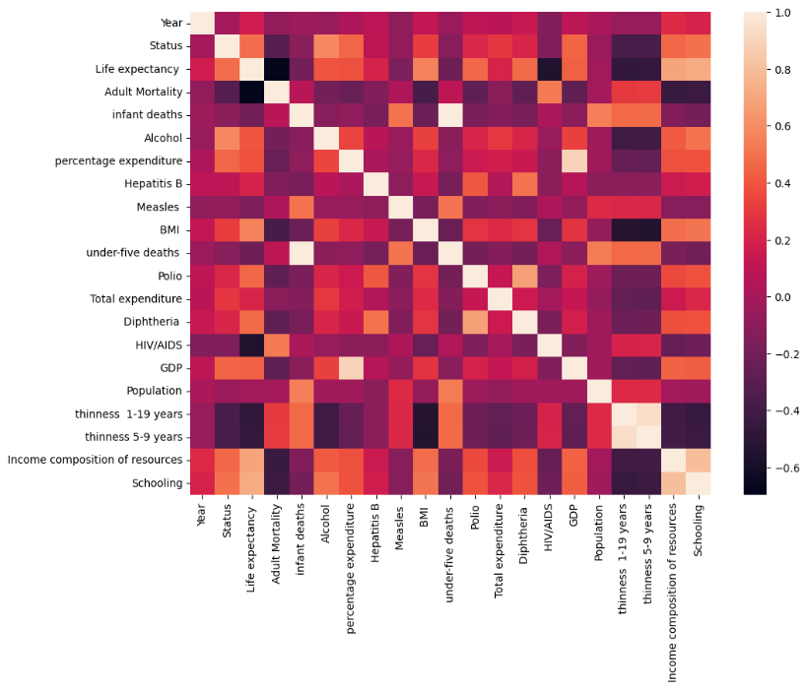
Results
Among the trained 4 models, Random Forest model produced the best results:
It has the accuracy of 95%.
Linear regression model has accuracy of 80%.
Decision Tree has accuracy of 90%.
Ridge regression has accuracy of 80%.
We made every model to predict the life expectancy.

